Slide 1
MLUG Coding Challenge 10/02/21
Leah Edwards MEng CLA
Notes:
Good afternoon
My name is Leah Edwards and I’m here to present my solution to the most recent MLUG coding challenge

Slide 2


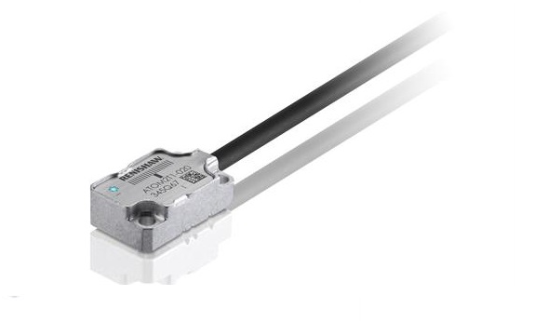
About Me
Process Development Engineer @ Renishaw
Working on Position Encoders: processes for manufacturing and test
Originally a Midlander! Now living near Gloucester.
Notes:
I’ll start by introducing myself
Not in midlands, like a lot of you probably
Always a Midlander at heart

Slide 3

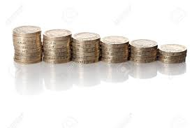
Agenda
The problem
The maths
Nested loops solution
Recursion solution
Notes:
Feel free to shout out questions, won’t be looking at the chat

Slide 4
The Problem
Coin/Note | Quantity | Sub Total
£ 10.00 | 1 | £ 10.00
£ 5.00 | 1 | £ 5.00
£ 2.00 | 4 | £ 8.00
£ 1.00 | 5 | £ 5.00
£ 0.50 | 3 | £ 1.50
£ 0.20 | 6 | £ 1.20
£ 0.10 | 4 | £ 0.40
£ 0.05 | 3 | £ 0.15
£ 0.02 | 10 | £ 0.20
£ 0.01 | 5 | £ 0.05
Total |  | £ 31.50
I went to the supermarket to get some beers for the Euros final and my bill came to £11.99. With the money detailed in this Excel spreadsheet, how many combinations are there that make up the exact change to pay my bill?
Questions
Does it matter which coin you use?
How will I prove that the answer is correct?

Slide 5
Brute force solution?
Coin/Note | Quantity
£ 10.00 | 1
£ 5.00 | 1
£ 2.00 | 4
£ 1.00 | 5
£ 0.50 | 3
£ 0.20 | 6
£ 0.10 | 4
£ 0.05 | 3
£ 0.02 | 10
£ 0.01 | 5
Total | 42
Can we check each combination if each coin of the same denomination is seen as different?
We have 42 coins. For each coin, we have 2 options: use it or don’t use it.
→2⁴² potential combinations that we could make = 4.4x10¹² i.e. 4.4 trillion.
111111111111111111111111111111111111111111

Slide 6
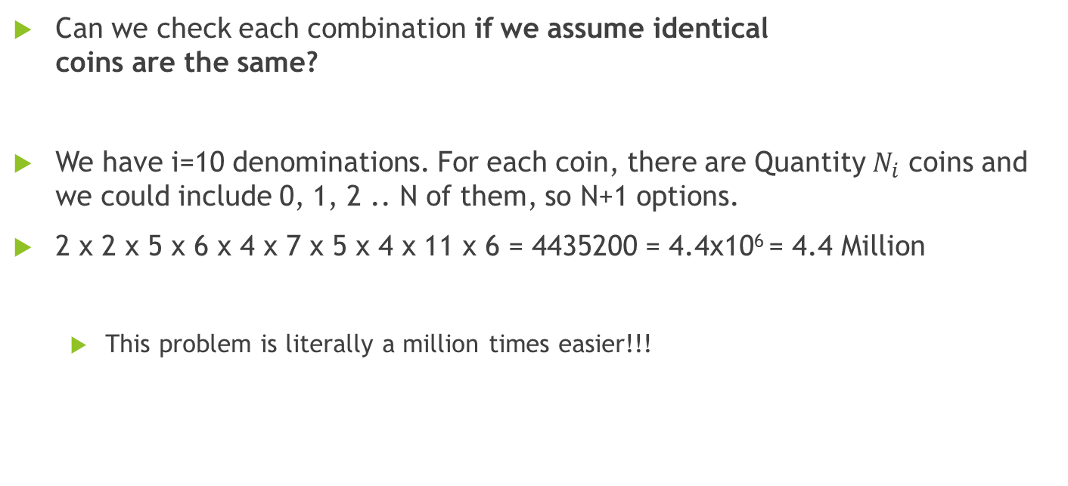
Brute force solution?
Coin/Note | Quantity
£ 10.00 | 1
£ 5.00 | 1
£ 2.00 | 4
£ 1.00 | 5
£ 0.50 | 3
£ 0.20 | 6
£ 0.10 | 4
£ 0.05 | 3
£ 0.02 | 10
£ 0.01 | 5
Can we check each combination if we assume identical coins are the same?
We have i=10 denominations. For each coin, there are Quantity $N_{i}$ coins and we could include 0, 1, 2 .. N of them, so N+1 options.
2 x 2 x 5 x 6 x 4 x 7 x 5 x 4 x 11 x 6 = 4435200 = 4.4x10⁶ = 4.4 Million
This problem is literally a million times easier!!!

Slide 7
First attempt
<Demo>
Super simple and it gets the answer…
But it’s not scaleable and could be much better!
Notes:
Top tip, zoom in with scroll wheel on teams
Sat down and did it on paper
Show amounts
Pretty much brute forcing it
Disable the conditional terminal
Drop a wait function in to show them how it counts up
Show time with disabled display updates

Slide 8
Optimisations
Conditional terminal
No display updates
Recursion
Notes:
It’s actually slower
Only used recursion at uni

Slide 9
Thanks for listening! Any questions?
LinkedIn: linkedin.com/in/leahmedwards
Email: leahedwards95@gmail.com
Notes:
Say about rounding errors dbl

Slide 10
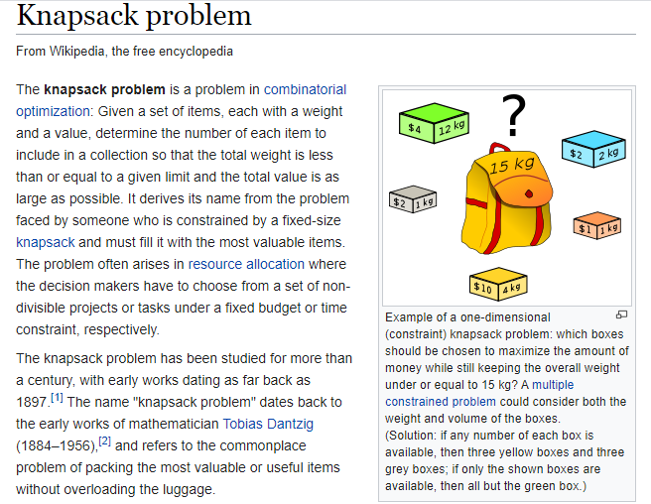
The Knapsack problem
https://en.wikipedia.org/wiki/Knapsack_problem
Notes:
https://en.wikipedia.org/wiki/Knapsack_problem

Slide 11
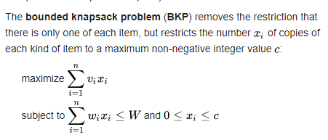
Notes:
Weights are money

